Slide 1
The Home Buyers Haven
Concept note

Slide 2
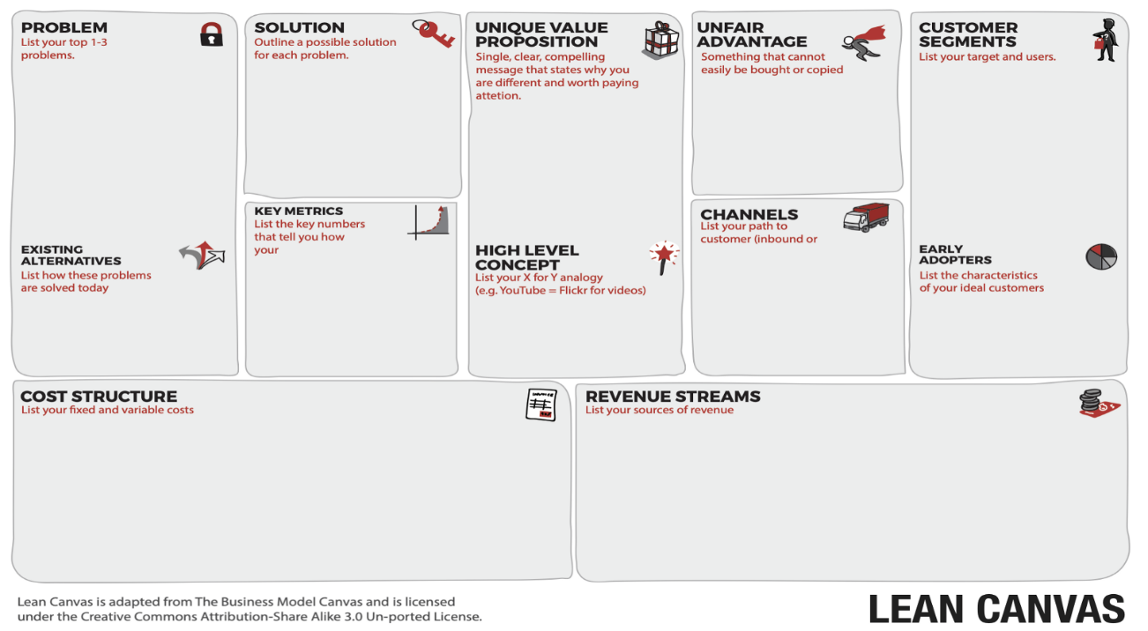
Lean Canvas
2
4
5
9
1
7
6
8
3

Slide 3
The Business Model: Lean Canvas
2. Problem Overpriced homes by selling agents and buying brokers Too many houses and selling sites to sift through Opportunity – Glut of mid-income houses Existing Alternatives RE Agencies whose platforms are set up for sellers RE Brokers who source property for buyers | 3. Solution Reduced house prices, closer to home buyers price No sifting thru many RE Agency sites, homes | 4. Unique Value Proposition The Buyer is King - Define your housing needs and get competitive offers hustle-free High-level Concept HBH is an RE Agency that prioritizes the buyer and reduces the hustle in the property search process |  | 5. Unfair Advantage *??Something that cannot be easily bought or copied *Uber – low-priced rides at the push of a button *HBH – Own a Home at your Price | 1. Customer Segments Home Buyers within Kenya Home Buyers in the Diaspora Early Adopters Aspiring home owners in mid-income segment
 | 7. Key Metrics Number of buyers signing up Number of closed deals Income generated |  |  | 9. Mktg & Customer Retention Market the platform – ref TCP Give free real estate info to draw viewers Channels - Website, Emails, Social media, User-referrals
8. Cost Structure Product / Platform development Marketing costs Salaries - administrator |  |  | 6. Revenue Streams Fixed price for each sign-up by buyer. Revenues will increase when more buyers sign up. More buyers will sign up, thru referrals based on successful deals. But start with no sign up fee for the first 100 customers
Notes:
Revenues Stage 2: X% for each closed deal – from buyer – because we are reducing the hustle for the buyer. But this means we facilitate the purchase process.

Slide 4

The Product Design
Positioning
The Buyer is King - Define your housing needs and get competitive offers hustle-free
Product Features
Open account on platform – personal details (name, phone, email)
Place buying offer – Provide details of kind of property needed using pulldown menus + other details
Price
Sign-up Fee for Buyer
First year = 0
Afterwards = TBD
Place
Internet
Physical Evidence
Platform
Buyers account page
Pull down menu of property details
Payment page
People
Administrator
Marketer
Tech support
Promotion
Market the platform
Give free real estate info to draw viewers to platform
Mktg Channels - website, emails, social media, user-referrals

Slide 5
Project IME Plan
1 | Develop platform |  | Apr 2019
2 | Test platform | Put in a few buying requests and pilot placement of offers | May 2019
3 | Market platform to buyers | Are you interested in buying a home in Nairobi or its environs? Tired of sifting through a myriad of listings? Just place your order here and let sellers place offers | Jun 2019
4 | Market platform to sellers | Find sellers (owners) want to sell. Direct them to the buyers market | Jun 2019
5

Slide 6
The Platform

Slide 7

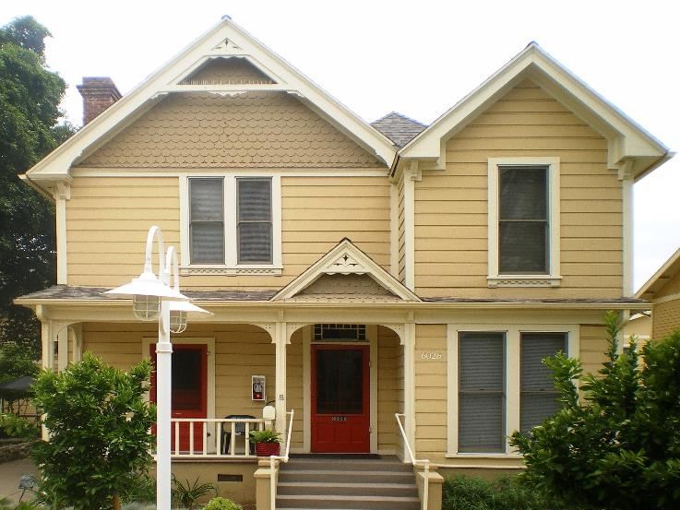
Web Page 1: Landing Page
The Home Buyers Haven
My Home, My Price
As easy as 1 – 2 – 3
State your price…
State your preference…
Let the sellers find you…
CLICK HERE for a new home buying experience
Notes:
Finding a home made easy
Are you interested in buying a home in Nairobi or its environs?
Are you tired of sifting through a myriad of web listings?

Slide 8
Web Page 2: My Home Search
Are You Selling?
You have an offer that matches my requirements?
CONTACT ME HERE

Slide 9
Back End:
Immediate
See contact details of buyer
See number of buy orders by buyer
Future
Payment platform – visa, mpesa
Have moderation before uploading order, to confirm payment. Ref. BuyRent Kenya
Have expiry dates of buy order. Ref. BuyRent Kenya

Slide 10
About Us
Option 1:
Owning a home is everyone’s dream. The Home Buyers Haven is an online platform that provides aspiring home owners an opportunity to purchase homes at friendly prices. With our motto 'My Home at My Price', we are prioritizing buyers needs and preferences and giving them a new home buying experience.
We believe that everyone should own a home at a location of their choice and at a reasonable price that matches their ability. Our platform is designed to facilitate this process by providing prospective home owners an opportunity to list their requirements and receive offers that match their needs.
Option 2:
Owning a home is everyone’s dream. The Home Buyers Haven is an online platform that provides aspiring home owners an opportunity to purchase homes at friendly prices.
We believe that everyone should own a home at a location of their choice and at a reasonable price that matches their ability. Our platform is designed to facilitate this process by providing prospective home owners an opportunity to list their requirements and receive offers that match their needs.
With our motto 'My Home at My Price', we are prioritizing buyers needs and preferences and giving them a new home buying experience.

